Slide 1
Paintball Environment Tactical Engagement Recon System (P.E.T.E.R.S.)
Group Number: BCC-4
Richard Taylor – C.E.
Anthony (AJ) Schmidt – E.E.
Kenneth Hale – E.E.
Brett Reich – C.E., E.E.
Antonio Foster – E.E.
Advisor
Dr. Christopher Peters – E.C.E.
March, 2016 – Winter Quarter
Notes:
Team Introductions

Slide 2
Presentation Outline
Problem Statement
Proposed Solution
Budget
Standards
Fall Progress
Winter Progress
Work Schedule / Timeline
Team Member Responsibility
Summary
References
Notes:
Antonio

Slide 3
Problem Statement
Our research indicates that there is currently no single product available that addresses all of the most common distractions that a player faces while playing the game of paintball.
Teammate location
Air pressure remaining
Paintballs remaining
We plan to utilize various sensors, a display, and a communication network to develop a single system which alleviates these distractions.
Notes:
Rick
Basically read slide. INCLUDE SAID DISTRACTIONS?

Slide 4
Proposed Solution
A system consisting of the following:
Honeywell Pressure Sensor mounted to air tank regulator
Collects real time data on available pressure in tank
Hopper with Ultrasonic Sensor System
Monitors available paint levels in hopper
Arduino Pro Minis with XBee Dongles
Wirelessly transmit data from sensors to server
Raspberry Pi 2 with Wi-Fi/XBee Dongles
Processes data
Share data between users
Recon Snow2 Heads Up Display (HUD)
Displays Information to the user
Transmits user GPS data to the Raspberry Pi
Notes:
Basically read slide
AJ

Slide 5
Proposed Solution – Block Diagram
Notes:
This slide shows the basic overview of how our system will work. Solid lines indicate wired connections, while dashed lines indicate wireless communications. In the top left you’ll see the pressure sensor. The pressure sensor is hardwired directly to the Raspberry Pi which is the central point for data processing and communications. Below the pressure sensor in the bottom left is the break-beam sensor circuitry. This will also be hardwired to the Raspberry Pi but has an optional wireless connection in which sensor data can be sent to the Raspberry Pi wirelessly by an Arduino board. In the top right, you’ll see the Snow2 HUD. This Snow2 HUD will communicate with the Raspberry Pi wirelessly and bi-directionally. It will receive visual information such as maps and alerts from the Pi and will transmit GPS information back to the Pi.
AJ

Slide 6
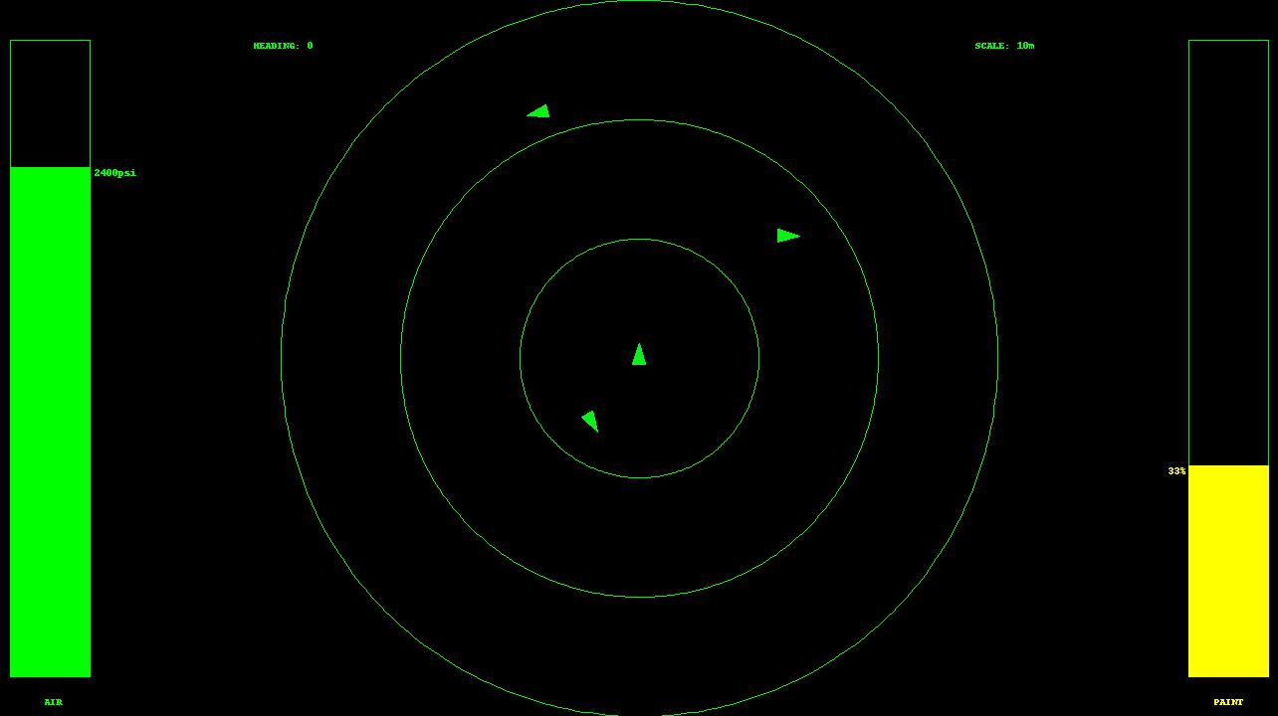
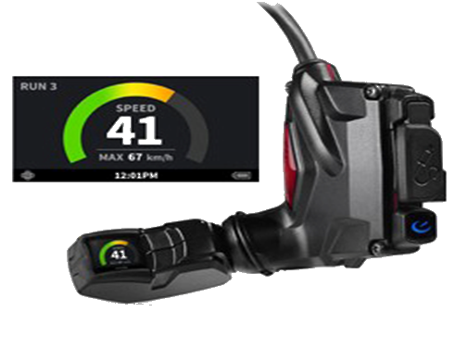
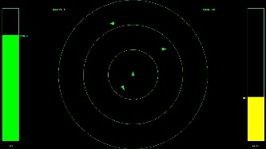
Proposed Solution – HUD GUI
Notes:
Rick
“Depicted here is a screen-capture of the GUI display that will be projected onto the HUD; this is the current iteration of how the data pertinent to the user will be displayed. The amount of air remaining in the user’s tank is depicted in the bar graph on the left, relative teammate position is indicated in the ‘scope-view’ in the center, and the amount of paintballs remaining in the loader is depicted in the bar graph on the right.”

Slide 7
Budget – Out of Pocket
Model Name | Unit Cost | Units | Sub-total
AA Battery Pack | $19.49 | 2 | $38.98
Micro-Bluetooth 4.0 LE | $8.99 | 2 | $17.98
Micro-SD 16GB (Sony 70Mb/s) | $8.99 | 2 | $17.98
CanaKit Raspberry Pi 2 + case | $46.99 | 2 | $93.98
SNOW2 (HUD only) | $399.00 | 2 | $798.00
MLH05KPSL06A – Pressure Sensor | $146.14 | 2 | $292.28
Photo-Resistor (20pcs) | $4.69 | 1 | $4.69
SNOW2 (HUD + Goggles) | $549.00 | 1 | $549.00
Laser Diode (5 pcs) | $3.54 | 1 | $3.54
Edimax EW-7811Un Wi-Fi Adapter | $9.99 | 2 | $19.98
Female / Male / Male 1/8th | $36.47 | 1 | $36.47
Shipping (for goggles) | $54.99 | 1 | $54.99
Arduino Pro Mini | $20.00 | 2 | $40.00
Adafruit 9-DOF LSM9DS0 | $20.49 | 1 | $20.49
 |  | Total | $1,988.36
 |  | Per Person | $397.67
Notes:
This is how much we’ve spent on the project so far. Our total cost comes to about $1900 total with each person spending around $385. The most expensive items were the Snow2 HUD and the pressure sensors.
AJ

Slide 8
Background Research - Standards
Standard ECMA-404 (JSON Data Interchange Format)
Standard IEEE 802.11 – Wi-Fi
Standard IEEE 802.13 - ZigBee
Standard IEEE 802.15 - Bluetooth
EPA regulation 40 CFR 273.13(a) (Waste management requirements for small quantity handlers of universal waste batteries)
Notes:
“Ken” - "Listed here are a few standards that were considered as applicable to the PETERS project. This Includes standard ECMA-404.(JSON data interchange), This is how we communicate to and from our Raspberry Pi and its peripherals.
Then there are IEEE 802.11 and 802.15 which cover Wi-fi and Bluetooth respectively. However because we are only using off the shelf wireless devices, these standards are already satisfied.
Because The Snow2 uses a lithium Ion battery, another applicable standard is EPA regulation 40 CFR 273.13(a). This standard talks about the proper handling of batteries and how they must be sealed and non-leaking at all times.

Slide 9
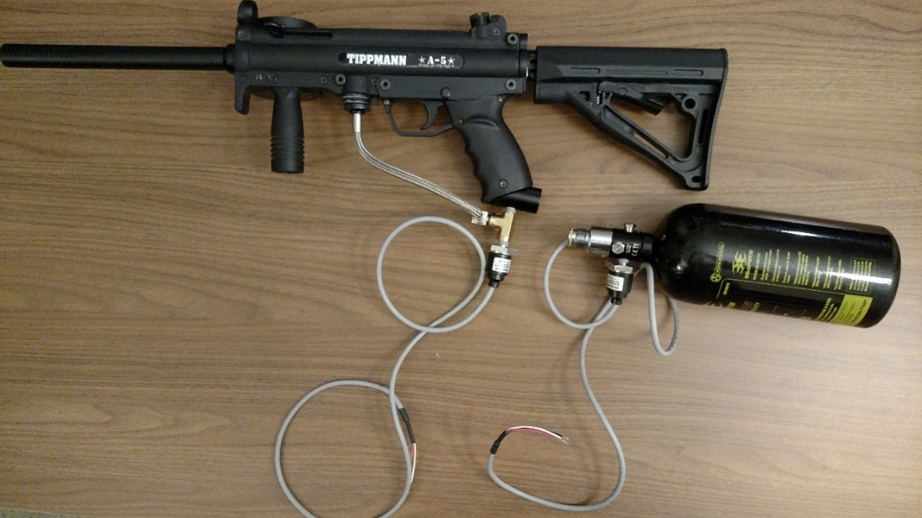
Fall Progress – Hardware
All equipment purchased and acquired
Honeywell Pressure sensor mounted and tested in 2 locations
Gathered important data using Arduino
Preliminary Break Beam Feasibility Test Completed
A
B
A – Pressure Sensor Mounted on Marker
B – Pressure Sensor Mounted on Tank
Notes:
Antonio

Slide 10
Fall Progress - Software
Base classes for GUI display framework
Moving Map Overlay
Utility classes (i.e. Latitude/Longitude to Pixel Position)
Supplemental classes (i.e. overlay constructors, icons, alert formatting, etc.)
Air Tank Readout and Paint Level Overlay
Python Application Packaging for Android
Basic network framework
Communication of JSON formatted messages
Data Collecting Utility
Gathered important data from Pressure Sensor
Paint detection algorithm
Notes:
Rick
“During the fall term, all of the base Python classes to be used as a framework to create the GUI display for the HUD were laid out; these classes were to form the basis for what is now a fully functioning GUI display. The utility classes and constructors were also created to support generation of the individual GUI components. In addition, a process for packaging Python applications for utilization on an Android platform was created. This process relies on third-party Kivy software utilities and formats the entire Python GUI application into an appropriately structured Android executable.”
Brett

Slide 11
Winter Progress - Hardware
Paint Level Detection System (Completed)
Components:
Accelerometer/Gyroscope – Track orientation of marker so only meaningful data is used
Ultrasonic Sensor – Measures current paint level in user’s hopper
Arduino Pro Mini – Microcontroller to collect data from sensors
XBee – Wireless serial communication with server
Battery – Removable and rechargeable USB 5V power bank
Compressed Air Level Detection System (Model nearing completion)
Components:
Honeywell Pressure Sensor – Measures current air pressure remaining in user’s tank
Arduino Pro Mini – Microcontroller to collect data from sensor
XBee – Wireless serial communication with server
Battery – Removable, rechargeable USB 5V power bank

Slide 12
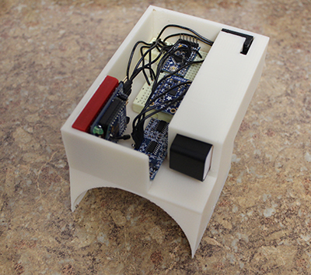
Winter Progress - Hardware
Measured Hopper Power Draw: 158mA @ 5V
Estimated battery life: 6 Hours, 18 Minutes
Solidworks 3D Model of Hopper Attachment
Realized Hopper Attachment with Circuitry

Slide 13
Winter Progress - Software
Estimated Data Rate Requirements:
MCU ->Sensor: s * [148, 15]
Sensor ->Server: [735, 12]
HUD ->Server: [18 + n*18, n*738]
Pos (HUD) ->Sensor: [220, 17]
Each Server ->Server: [18, 735]
MCU
Sensor
Server
External
Server
Pos(HUD)
HUD
Key:
Rate Units:
[Up/Down] (Bytes/Sec) * (Refresh Rate)
Expansion Scaling:
s → Number of Serial Sensor MCU Node Per Node (Normally s=1)
n → Number of Nodes Total (Normally n > 1)
Notes:
Brett

Slide 14
Winter Progress - Software
Estimated Data Rate Requirements:
MCU ->Sensor: s * [148, 15]
Sensor ->Server: [735, 12]
HUD ->Server: [18 + n*18, n*738]
Pos (HUD) ->Sensor: [220, 17]
Each Server ->Server: [18, 735]
MCU
Sensor
Server
External
Server
Significant Numbers:
Localhost Combined: 747
Node Internal Serial: s * [163]
Node Internal Socket: [984] + n * [753]
All External Socket: n * (n-1) * [753]
Total: n * 984 + (n*n) * [753] + n * s * [163]
Pos(HUD)
HUD
Key:
Rate Units:
[Up/Down] (Bytes/Sec) * (Refresh Rate)
Expansion Scaling:
s → Number of Serial Sensor MCU Node Per Node (Normally s=1)
n → Number of Nodes Total (Normally n > 1)
For Example:
n=5, s=1 Total: 23,810 bps
n=10, s=1 Total: 86,770 bps
Notes:
Brett

Slide 15
Winter Progress - Software
Break from previous design
Less-‘busy’ display
Tree cover
Implementation Time
Air / Paint level
Teammate position indicator
Wearer lat/long and heading
Teammate lat/long and heading
Haversine Formula
Wearer heading and scope scale
Server Communications
WiFi
In process of executing on HUD
Configure App permissions properly
HUD API Interfacing
Notes:
Rick
“For those of you who saw the previous iteration of the HUD GUI display, this current version will look a little different. The previous version of the HUD GUI displayed a satellite image of the actual playing field with the idea being that user icons would be plotted according to their actual location in reference to that satellite image. We decided to move in a slightly different direction in terms of how the display is configured. Since we are limited to a 428X240 resolution display, we don’t want to overload it with information and create a cluttered image; a satellite image from a suitable zoom level looks extremely muddled at this resolution. Since this display is to be referenced quickly in the field by the user, the information available should be presented in such a way that it is conveyed rapidly and doesn’t create another inadvertent obstacle for the user in terms of gaining a picture of his/her environment and equipment. In addition, many paintball fields are located in the woods under tree cover which really negates the usage of a satellite image. Also of concern was the amount of time it would take to actually implement a dynamic map-data download and distribution utility; we felt it may take too much time to implement this utility and so its been paused at least until we have full system integration. In terms of what is actually displayed on the GUI, on the left is a moving bar-graph representation of the air pressure remaining in the tank; this can display either in terms of a percentage of full or a PSI value. On the right is another moving bar-graph representation of the paintballs remaining in the loader; this will always display in terms of a percentage of full. In the center of the display is the teammate position indicator. The wearer’s icon is always located dead center and pointing straight up in reference to the GUI so that the wearer can always determine teammate location in terms of the direction he/she is facing currently. Teammate icons will be plotted around the wearer’s icon with their distance and bearing from the user being determined by their respective latitude and longitude coordinates. In addition, their respective headings relative to the current heading of the wearer are also displayed as the direction the icons are pointing. The plotting is done via utilization of the Haversine formula for calculating great circle distance between two points. The wearer’s compass heading and the current scale of the view are also both given. In addition to this, the GUI receives all of its required sensor and user information from the server via a WiFi network connection. Currently, the remaining task is to actually execute the GUI on the HUD; the tricky part will be dealing with the network operations permissions required for the device.

Slide 16
Work Schedule / Timeline
Notes:
Rick
NEED TO ADD CROSS-USER COMMS TO THIS AS WELL AS FURTHER HARDWARE WORK
NEED TO ADD ACTUAL TIME BARS (HOTDOG LINES)

Slide 17
Team Member Responsibility
Member | Completed | In Progress | Future
Richard Taylor | HUD GUI Development Assisted with Data and Communication server development | HUD Network Communication permissions HUD API Interfacing | Field Testing and Debugging
Brett Reich | Data and Communication Server Development Assisted with HUD GUI Development | Cross-User Communication HUD Network Communication permissions | Field Testing and Debugging
Kenneth Hale | Sensor Research Sensor Test and Evaluation Data Collection Methods Sensor Acquisition Framework | Sensor Acquisition Debugging Assist in Product Packaging | Assist in 3D Modeling Software Debugging Field Testing
AJ Schmidt | Sensor Research Sensor Test and Evaluation Sensor Data Collection Methods Hopper Attachment Design | Design Attachment for Air Tank in Solidworks Adjust Accelerometer/Gyroscope Restraints | Mask Modification Pi Enclosure Field Testing
Antonio Foster | Sensor Research Sensor Test and Evaluation Sensor Data Collection Methods Configure & Test XBee Network | Design Attachment for Air Tank in Solidworks Adjust Accelerometer/Gyroscope Restraints | Mask Modification Pi Enclosure Field Testing
Notes:
Group Talk
BRETT NEEDS TO TAKE A LOOK

Slide 18
Summary
Important technological change to a popular game
Eliminate common game distractions
Enable players to utilize pertinent data
Project Near Completion
Hopper attachment housing designed and 3D printed
Networking software developed
Server software developed
HUD GUI display software developed
Integration from sensor data to HUD software
Notes:
KEN NEEDS TO UPDATE NOTES
Ken - To summarize, Project PETERS is about making an important technological change to a popular game.
This change will eliminate common game distractions by providing the user with important real time data.
Although more work needs to be done a lot has been accomplished in the first quarter.
The most notable hardware steps include the Pressure sensor being mounted and tested, and initial testing of a break-beam system for a low paint count.
On the software side, the Networking software framework and the Display software framework both have been developed and tested.
We feel were are on track to complete project PETER’s by the end of March.

Slide 19
Demo Video

Slide 20
Addressing Comments
“Is it possible that the P.E.T.E.R.S. could be utilized for malicious purposes?” (Paraphrased)
Yes, the same could be said for any piece of communication equipment.
However our system would be useless in its current state to use for nefarious purposes for the following reasons
Our system utilizes unencrypted transmission
Our communication runs on a jammable consumer WiFi network
“Design content of E.E. vs Design of Software should be explicitly stated”
Hardware design and circuit construction was simplified by the nature of COTS.
Various electrical design considerations
Software to link all elements custom designed and implemented
Notes:
Ken –
Now we move to addressing comments made from our fall presentation. One comment was: ““It is possible that the P.E.T.E.R.S. could be utilized for malicious purposes.” While this is technically true, the same could be said for any piece of communication equipment. However, our system, in its current state, would be useless to use for nefarious purposes
for the following reasons. Number 1, our system utilizes unencrypted transmission, and number 2, our communication runs on a jammable consumer wifi network.
The other comment we received from our fall presentation was “Design content of EE. Vs Design of Software should be explicitly stated” The majority of our hardware design and circuit construction was based on COTS, and therefore there was no real need to develop any additional electrical components. However, there were various electrical design considerations such as power consumption, data rate, and even size. It should be stated that all of the mounting hardware to accommodate the sensor array and the actual mount for the mask have all had to be designed and built. As well all of the software has been custom designed and documented. (Note: I think they want basically what are the E.E.’s responsible for and what are the C.E.’s responsible for)

Slide 21
Work Schedule / Timeline
Notes:
Included to show a more detailed timeline of the work to be done.

Slide 22
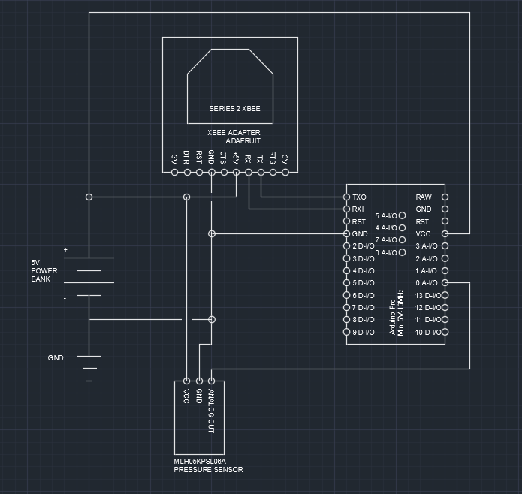
Compressed Air Tank Schematic

Slide 23
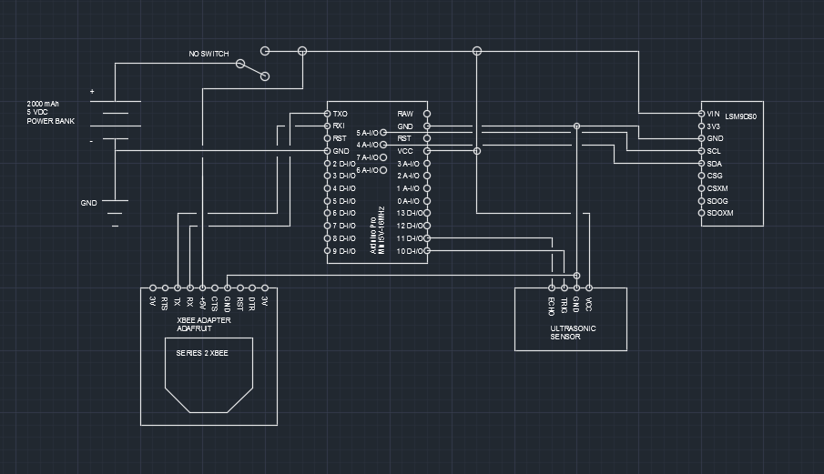
Hopper Schematic

Slide 24

Questions

Slide 25
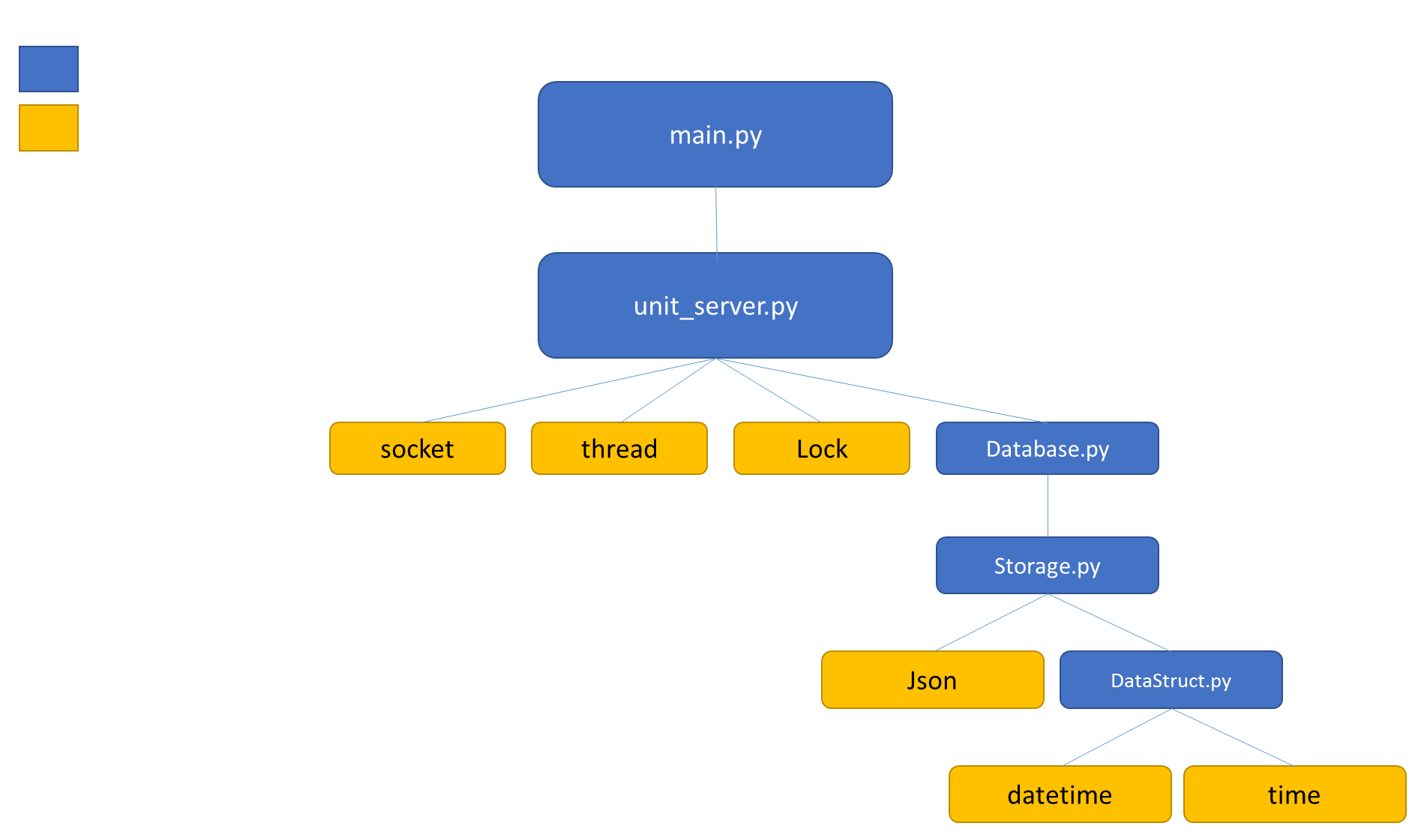

Slide 26
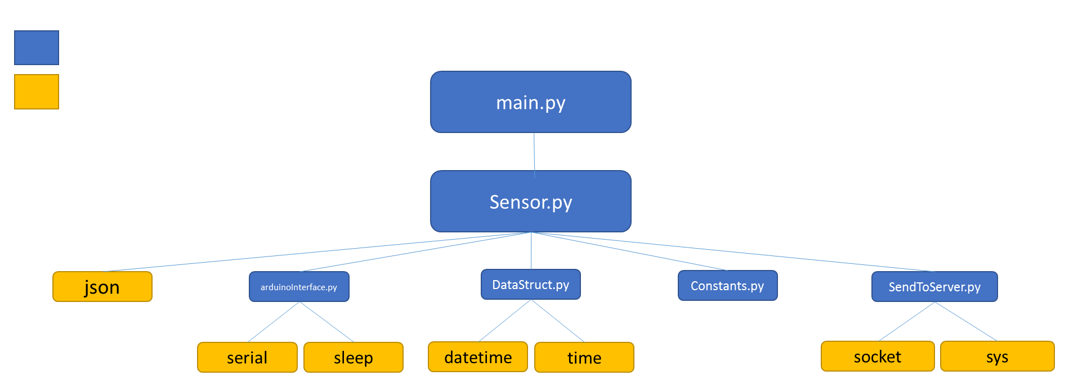

Slide 27
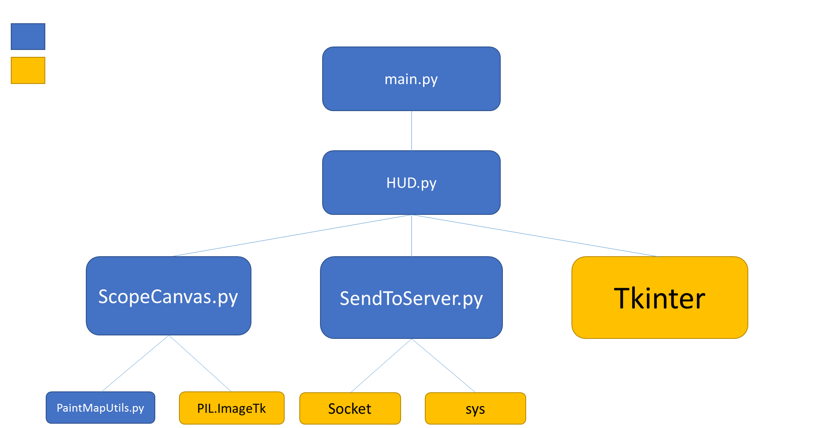

Slide 28
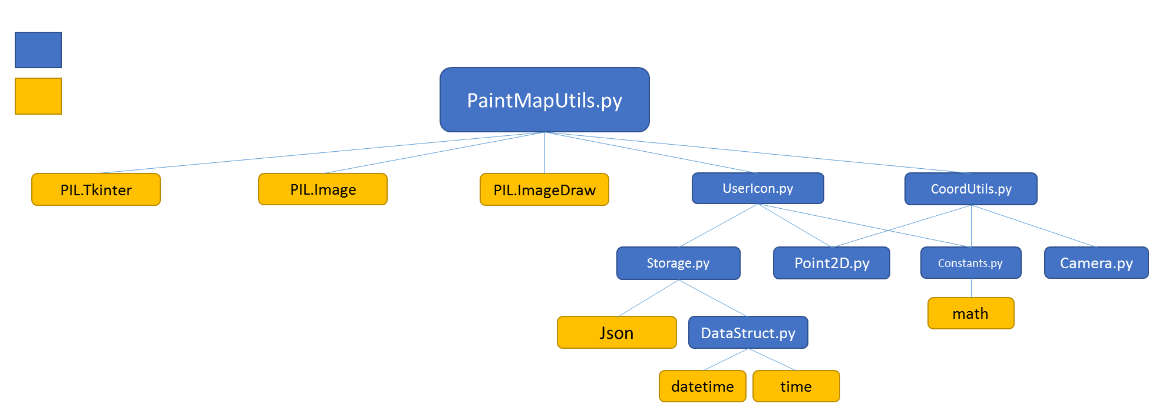

Slide 29
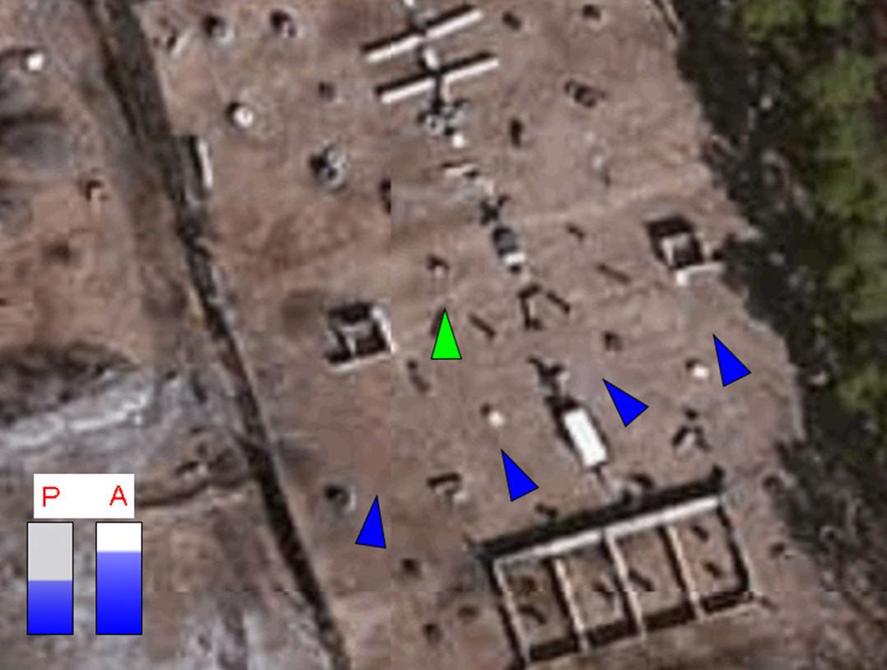
Previous HUD GUI Version

